Slide 1

CAPE WINELANDS
OLIFANTS RIVER

Slide 2
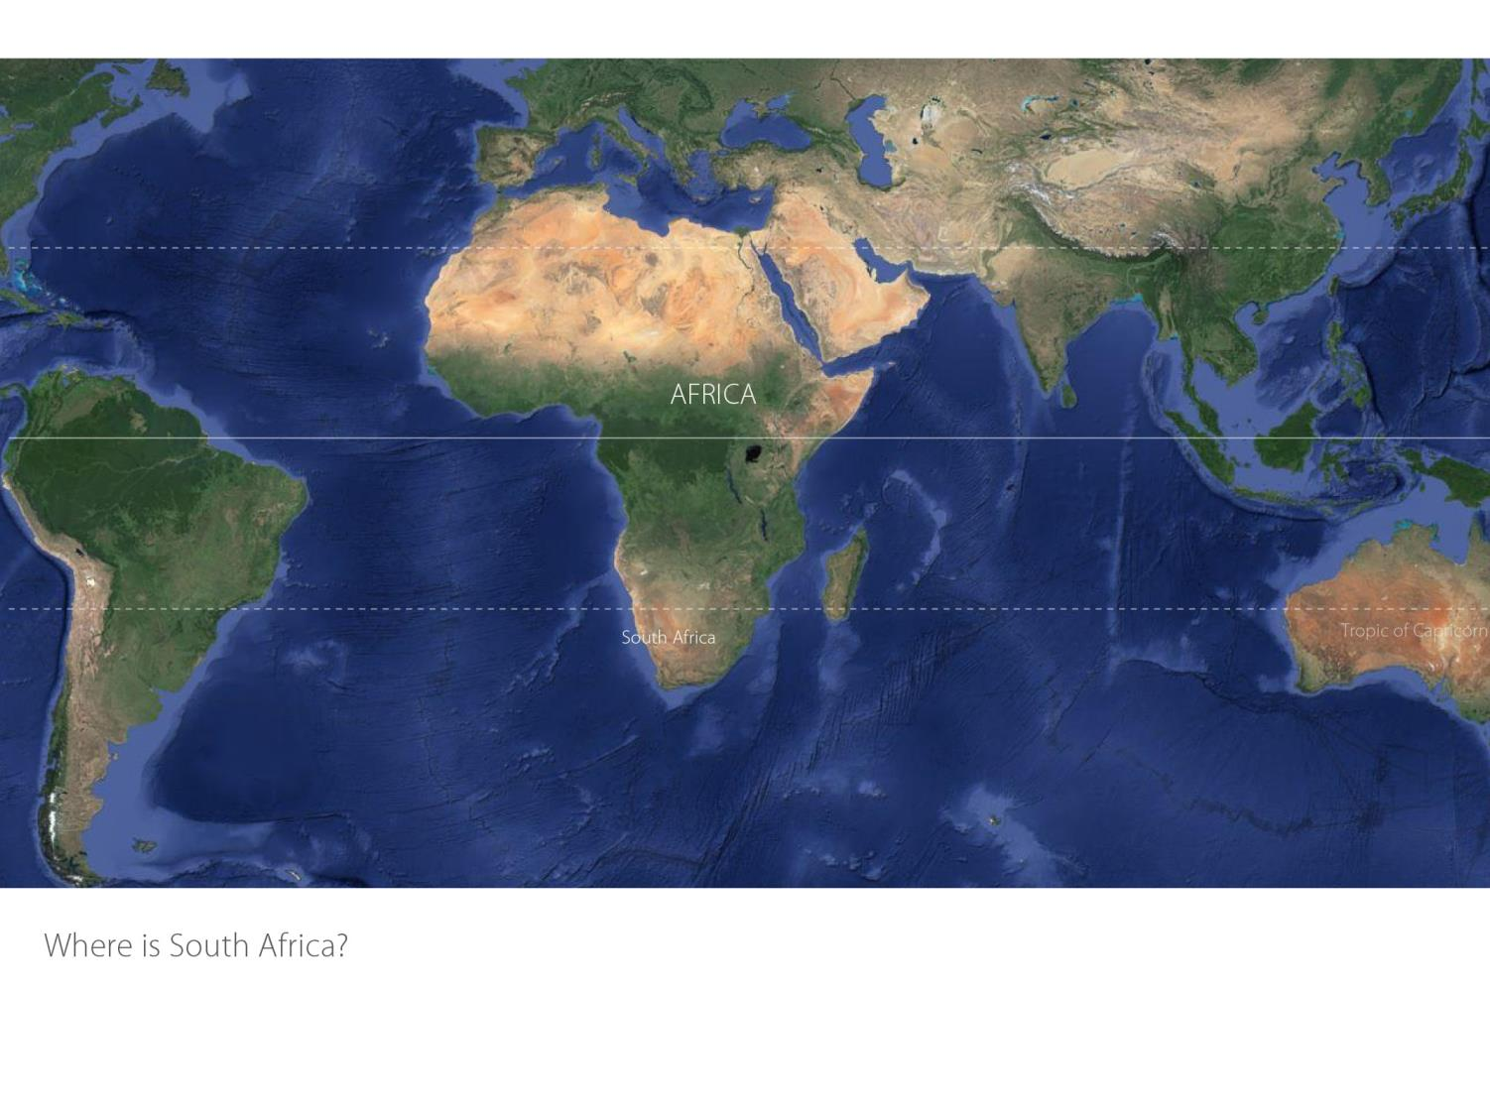

Slide 3
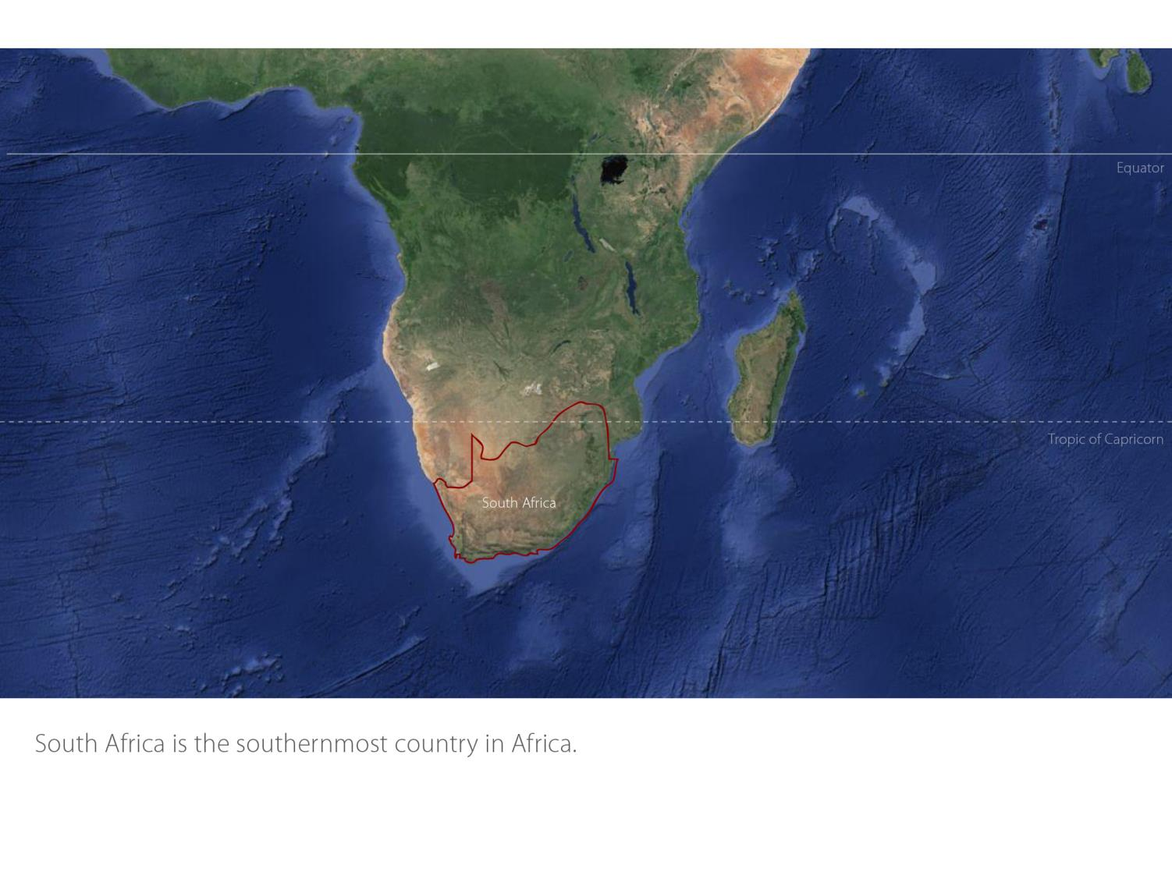

Slide 4
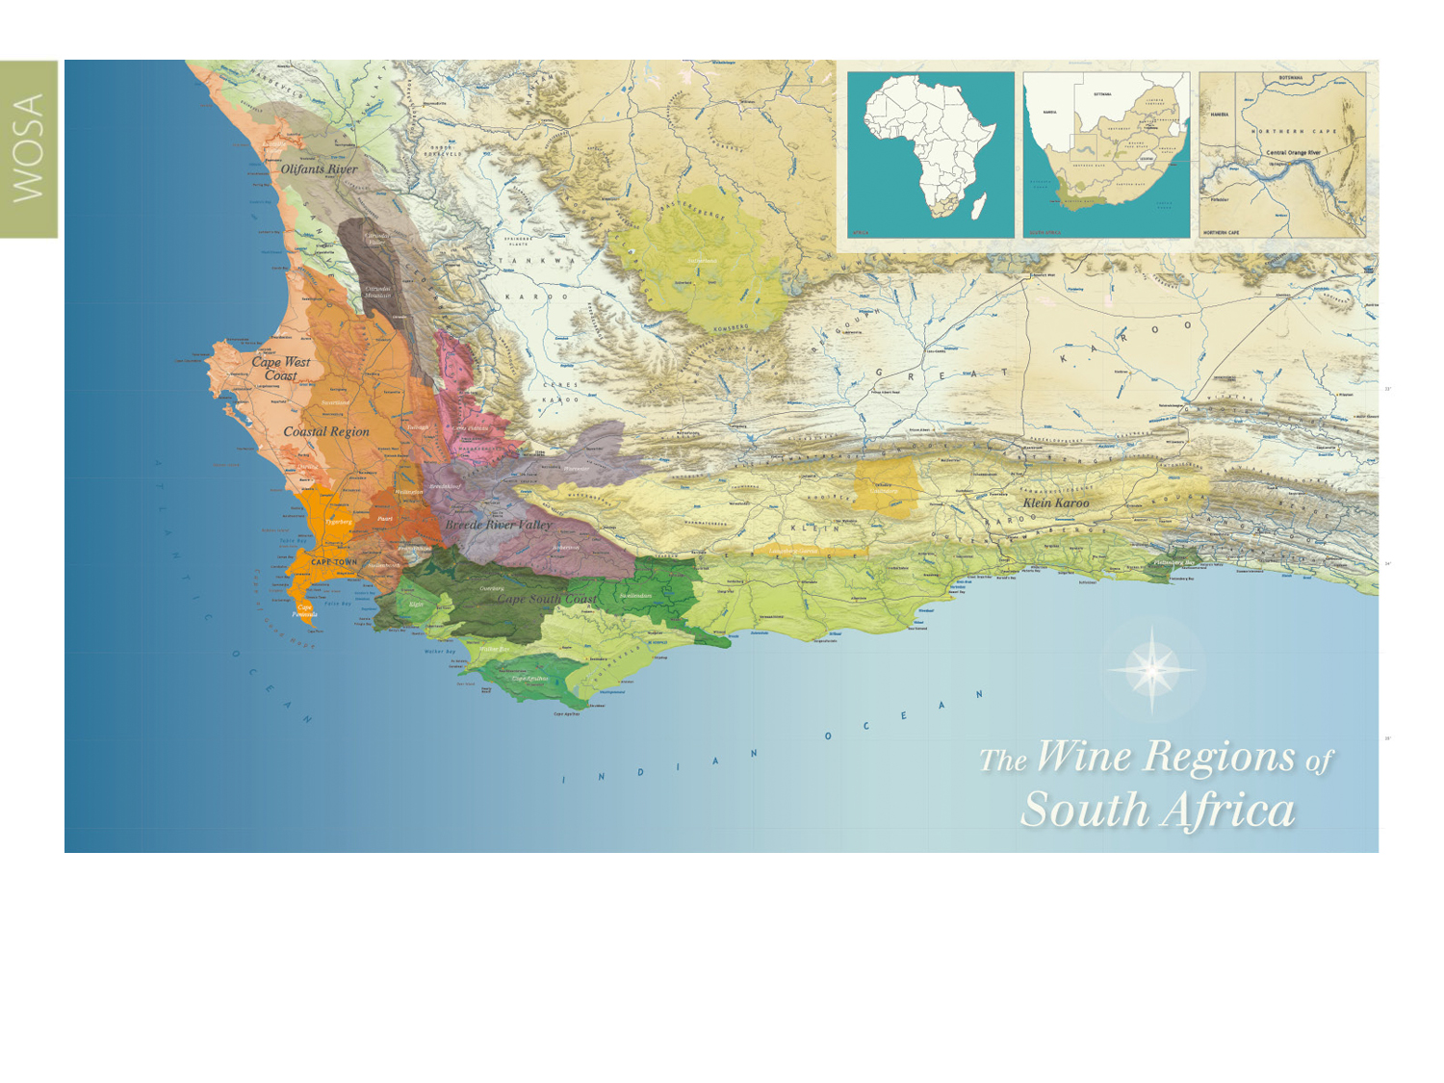
Our winelands are located at the very tip of South Africa.
Olifants River

Slide 5
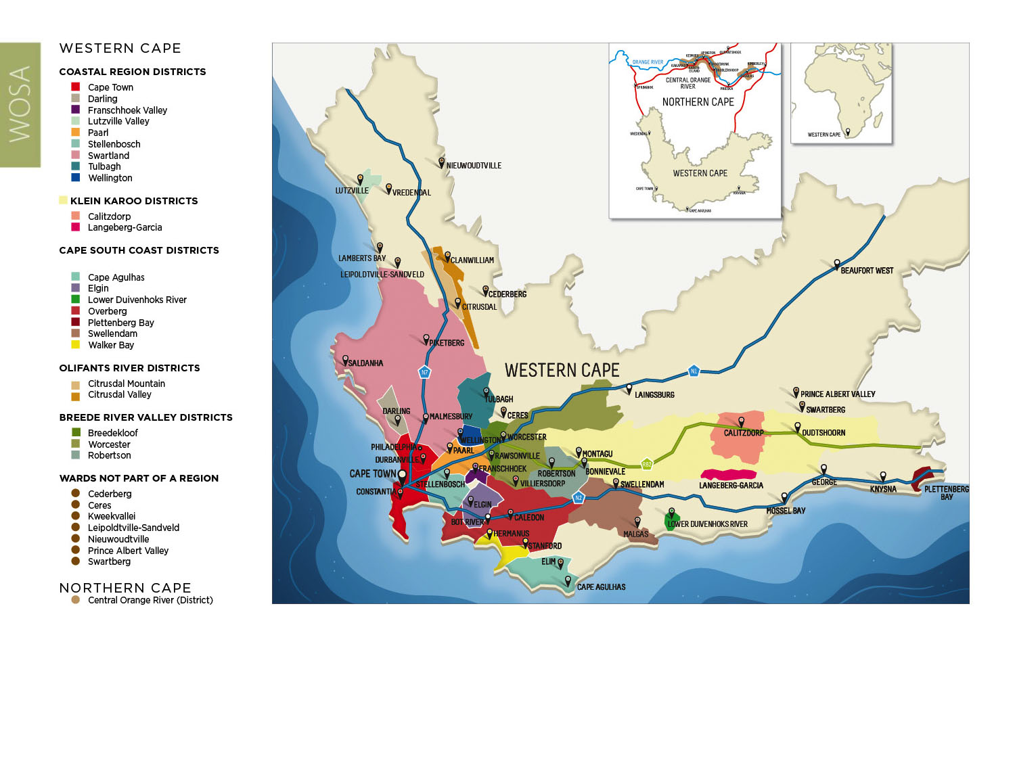
PRODUCTION AREAS: Districts of South Africa.
Olifants River

Slide 6
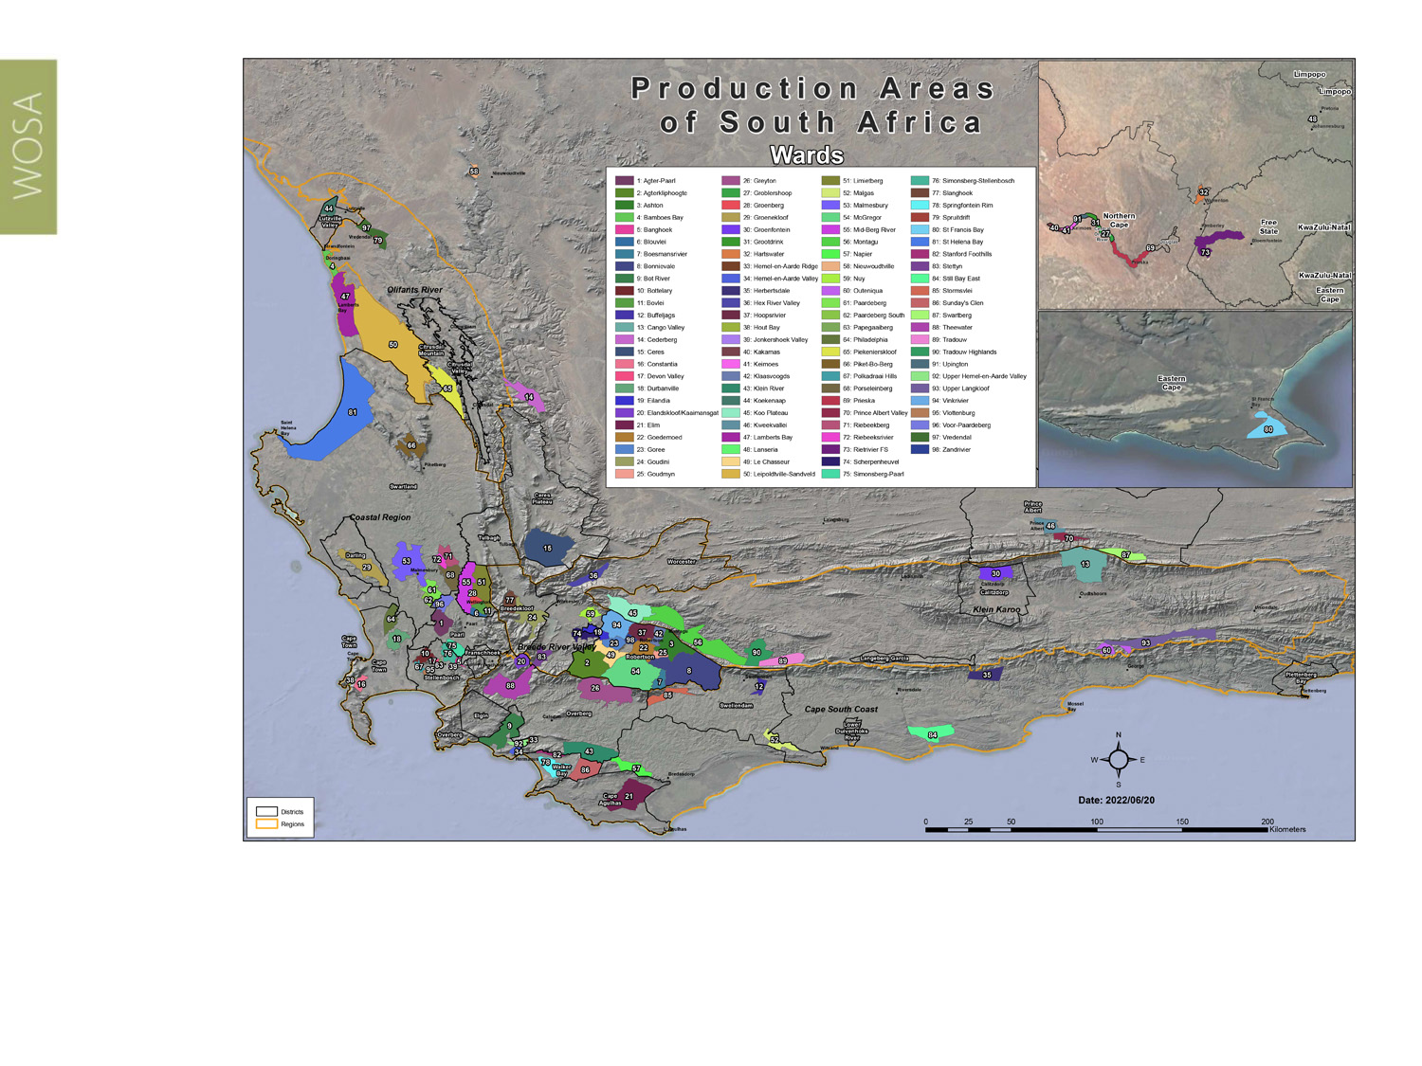
Wards of South Africa.
Olifants River

Slide 7
Olifants River
Region: Olifants River
Districts: Citrusdal Mountain
Citrusdal Valley
Wards: Piekenierskloof
Spruitdrift
Vredendal
Region: Coastal
Districts: Lutzville Valley
Ward: Koekenaap
Olifants River

Slide 8
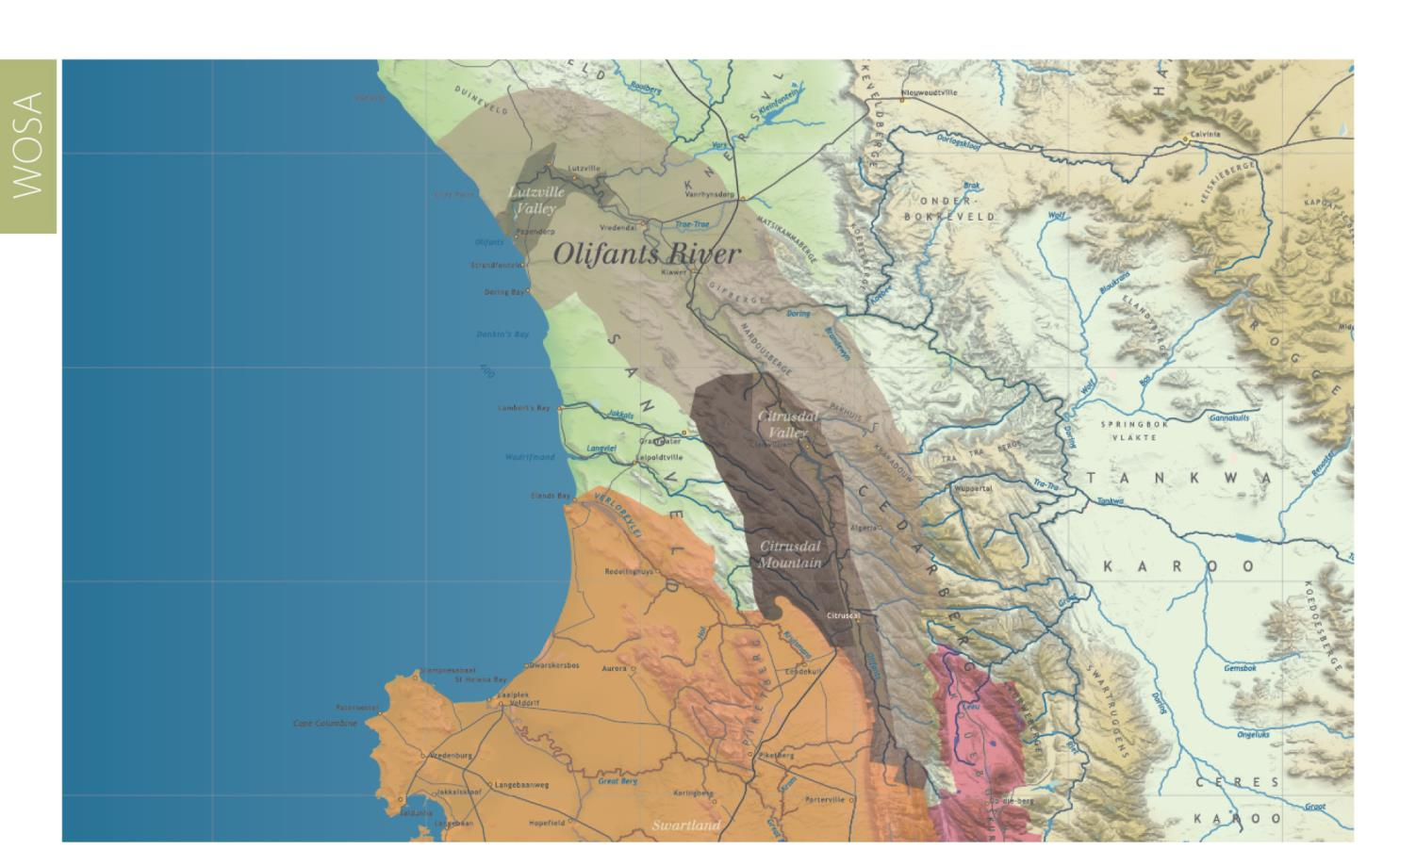
This winegrowing area runs in a belt from north to south along the broad valley of the Olifants River.
Olifants River

Slide 9
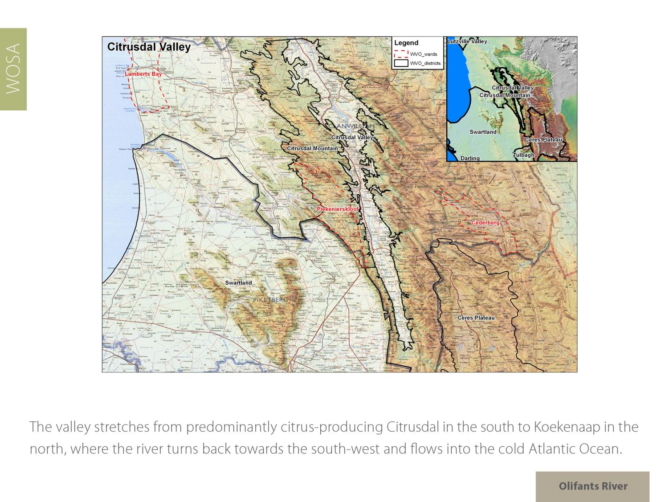
Olifants River

Slide 10
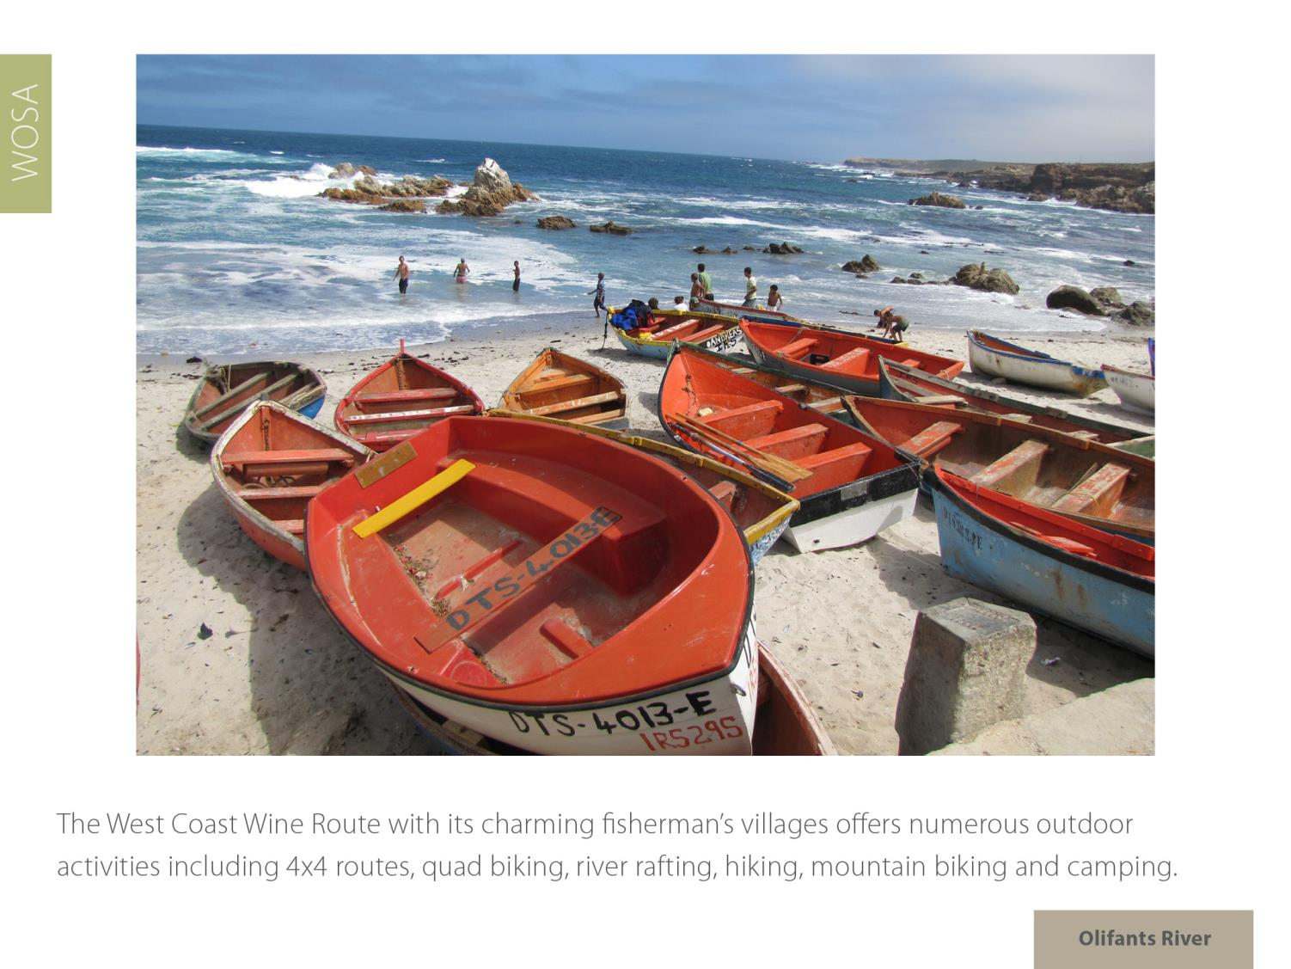
Olifants River

Slide 11
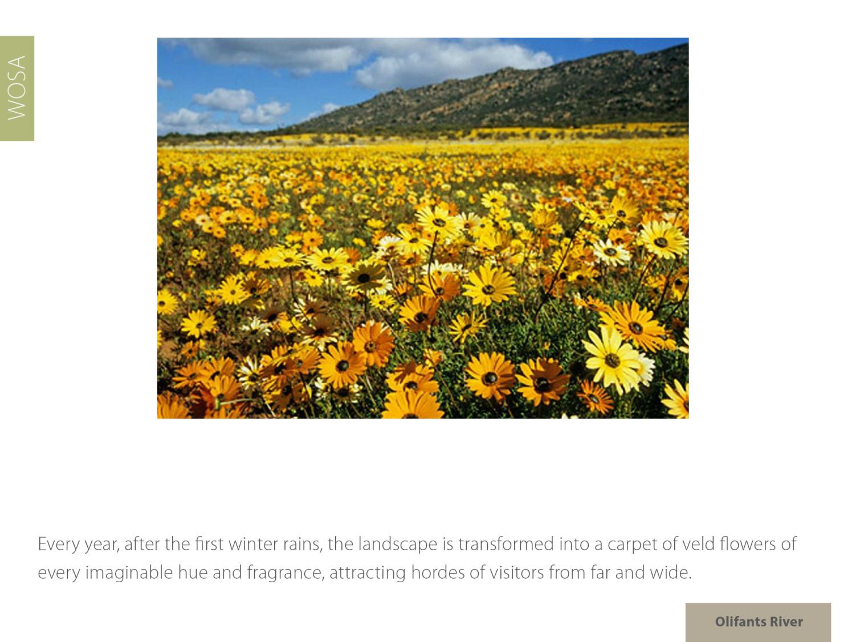
Olifants River

Slide 12
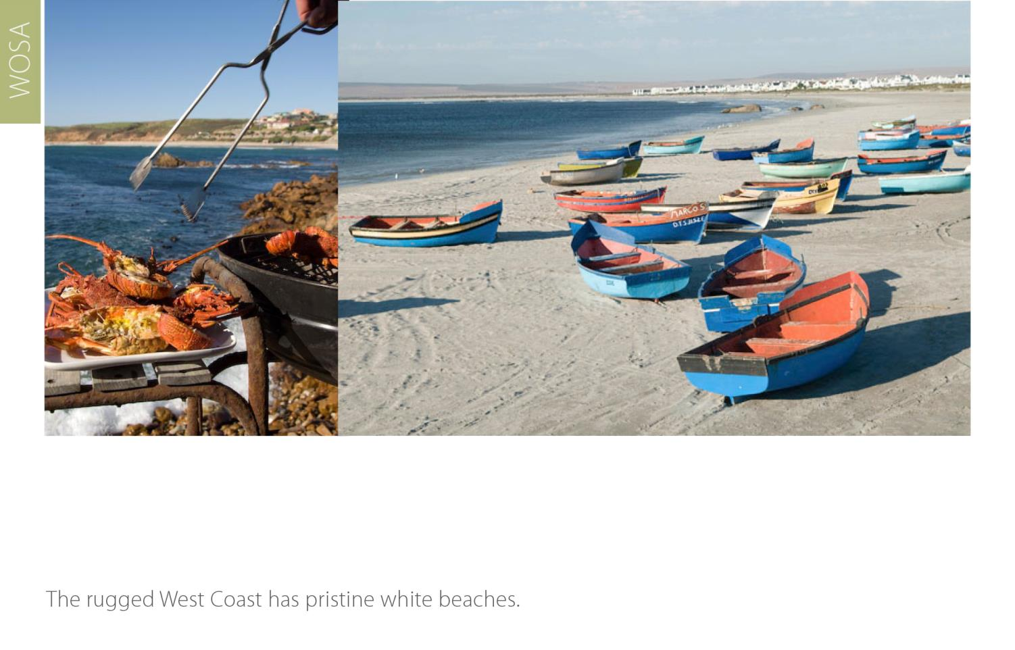
Olifants River

Slide 13
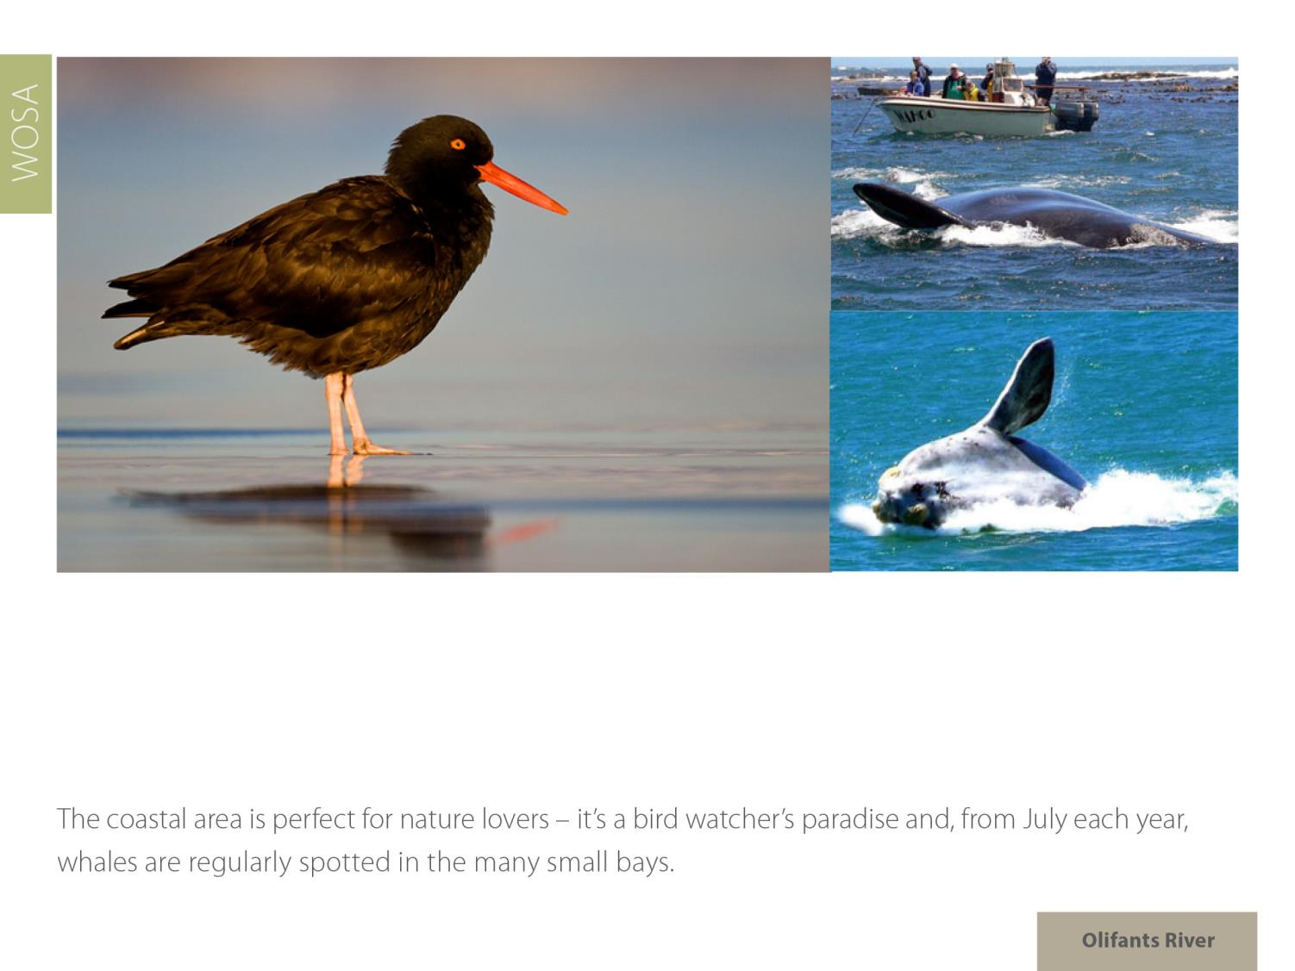
Olifants River

Slide 14
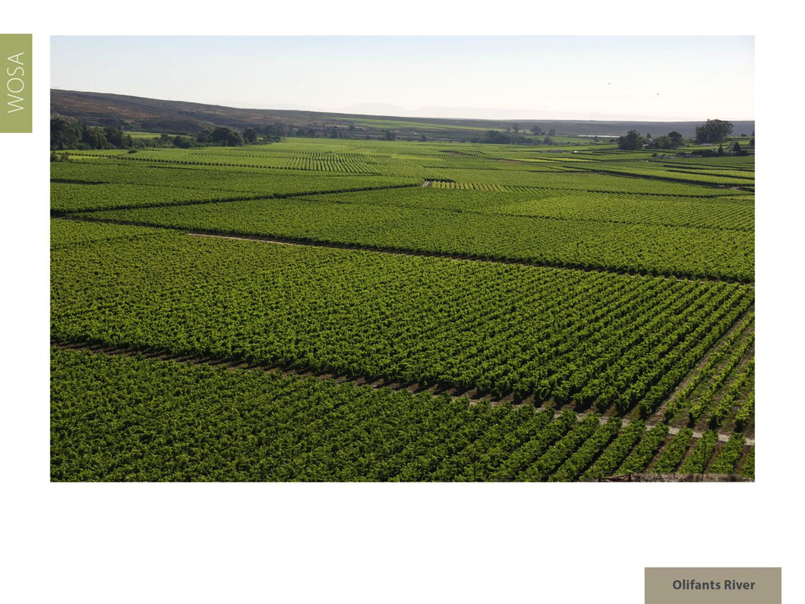
The summers in this valley range from relatively warm to cool compared with some of South Africa’s other wine regions.
Olifants River

Slide 15
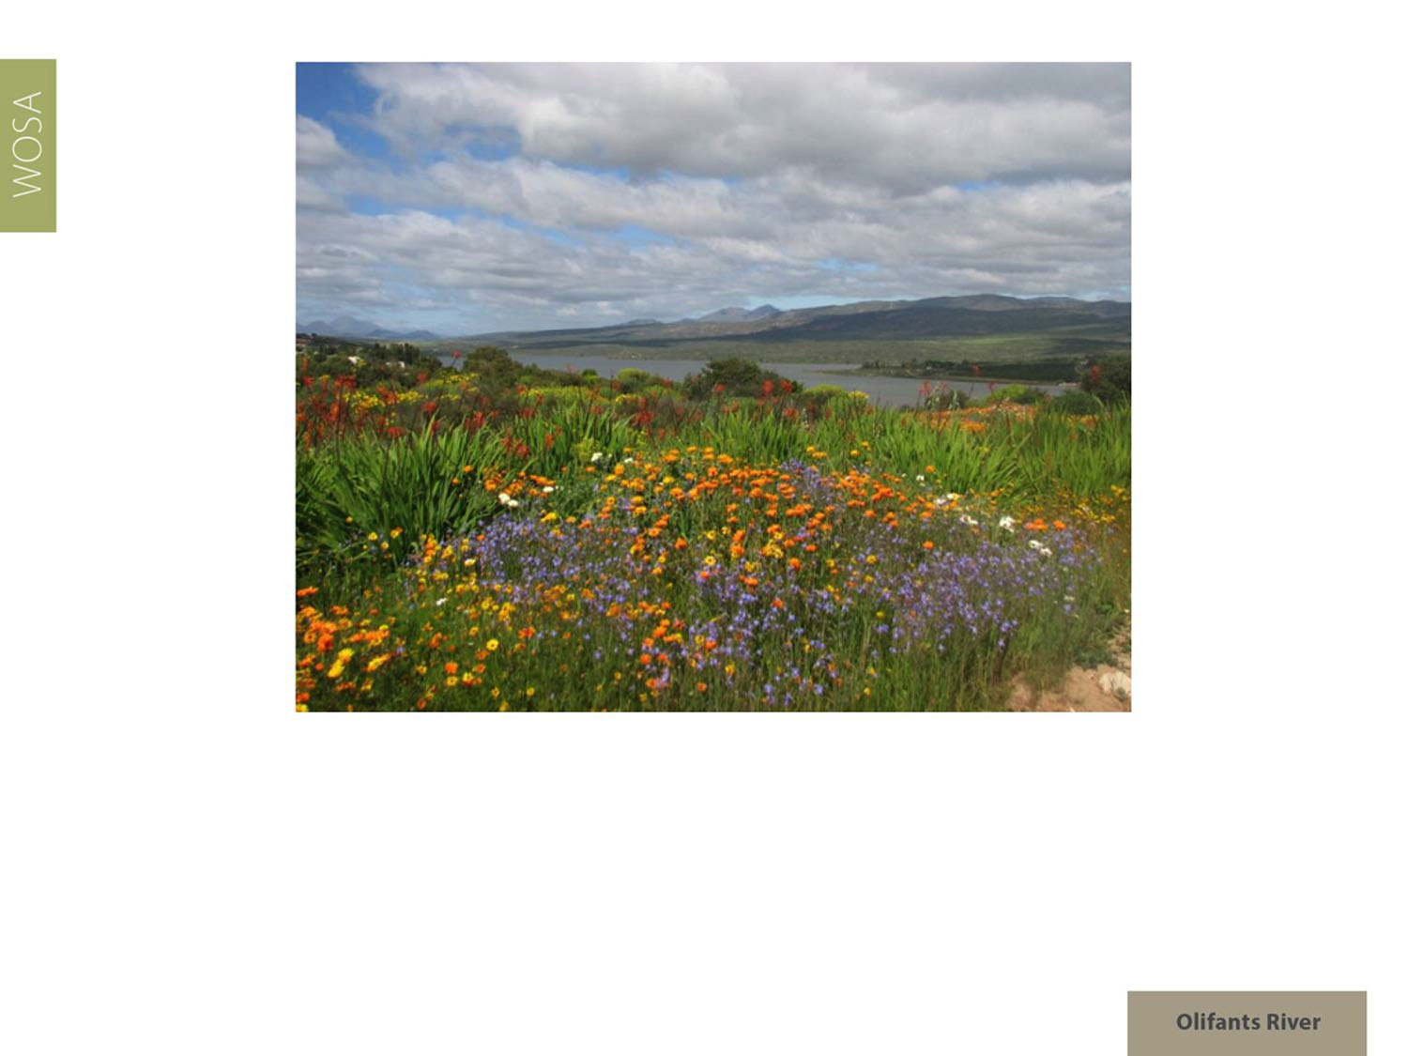
Rainfall in the region is low. The southern part of the valley up until Clanwilliam has an annual average rainfall of 370mm.
Olifants River

Slide 16
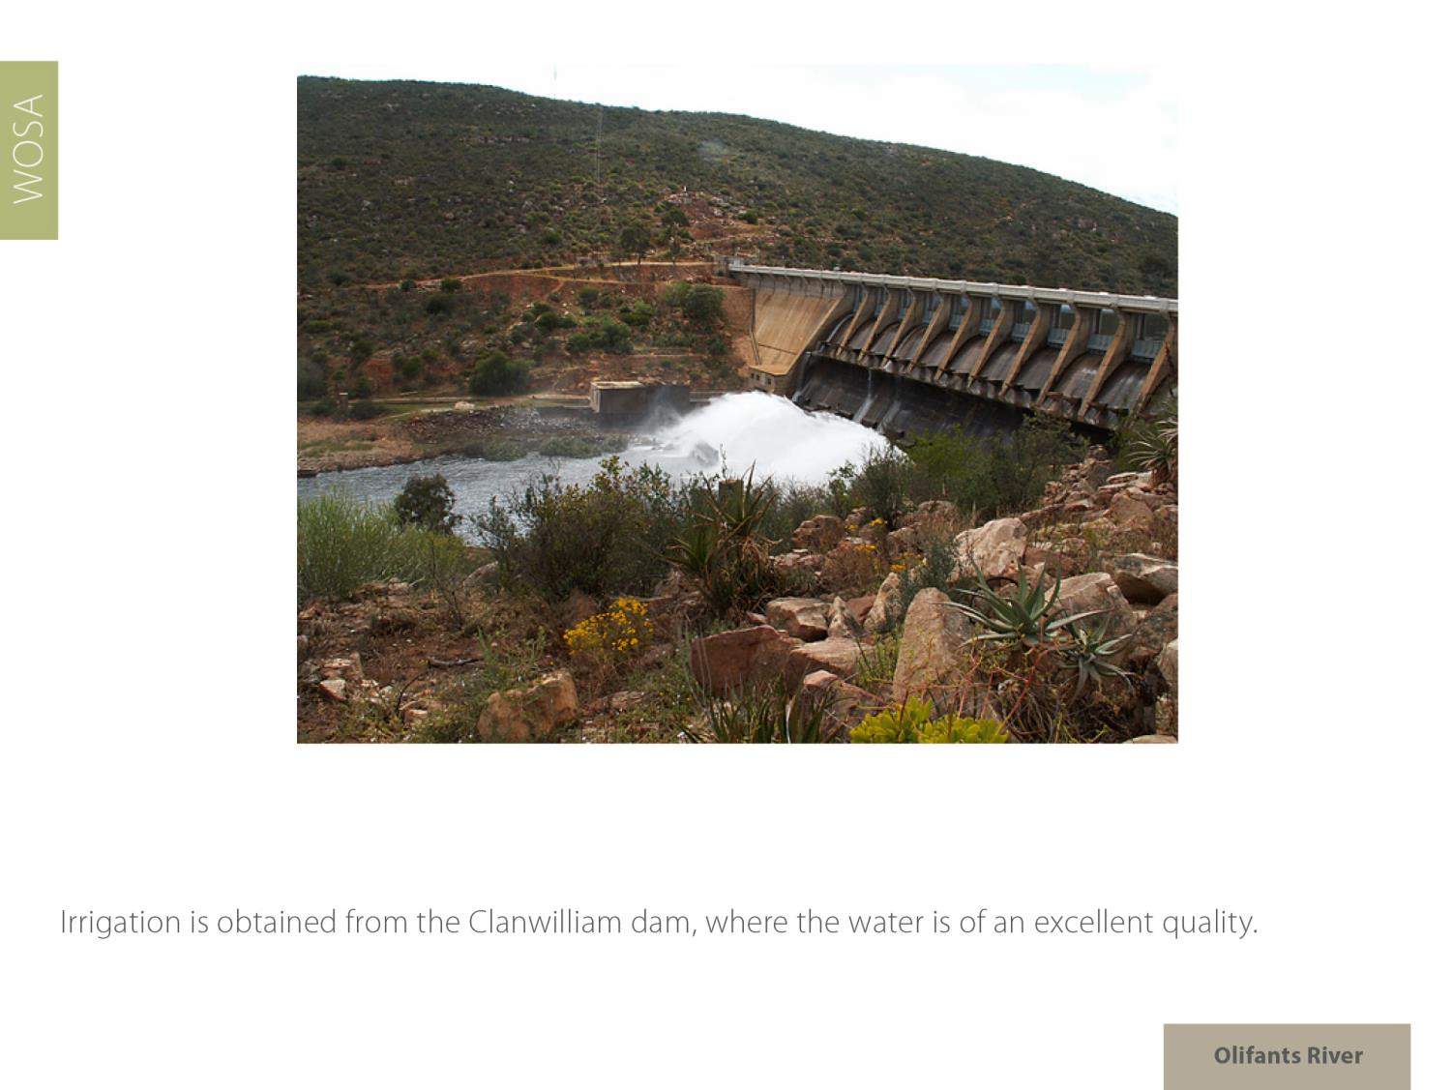
Olifants River

Slide 17
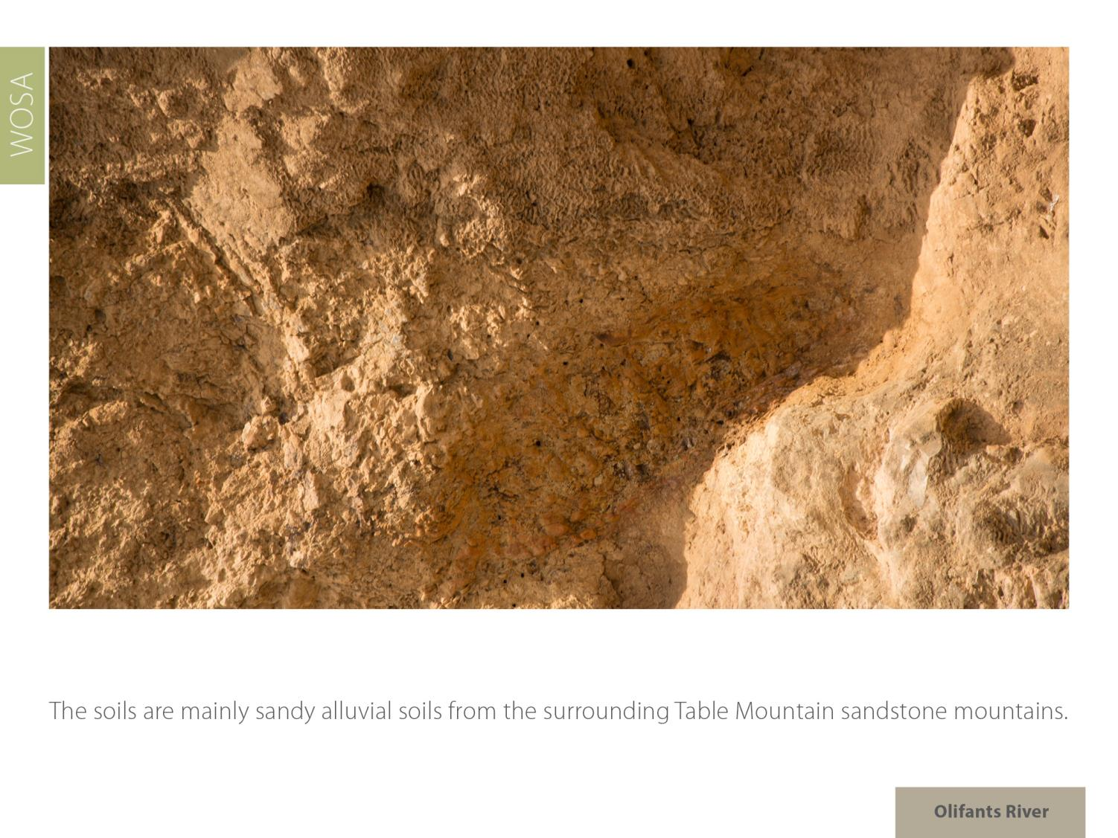
Olifants River

Slide 18
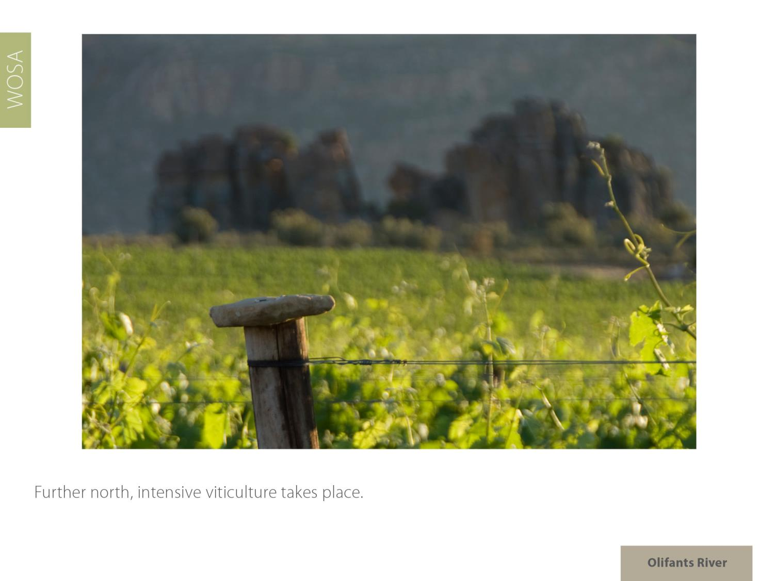
Olifants River

Slide 19
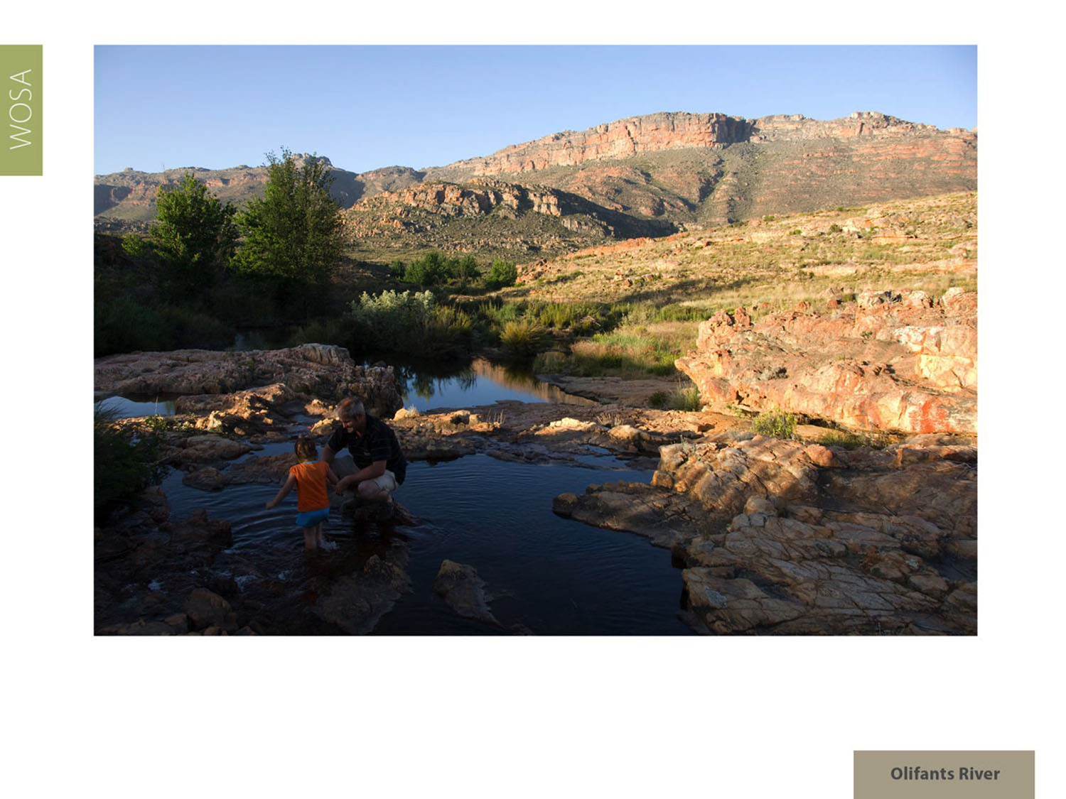
Here the climate is warm and the average annual rainfall is 220 mm.
Olifants River

Slide 20
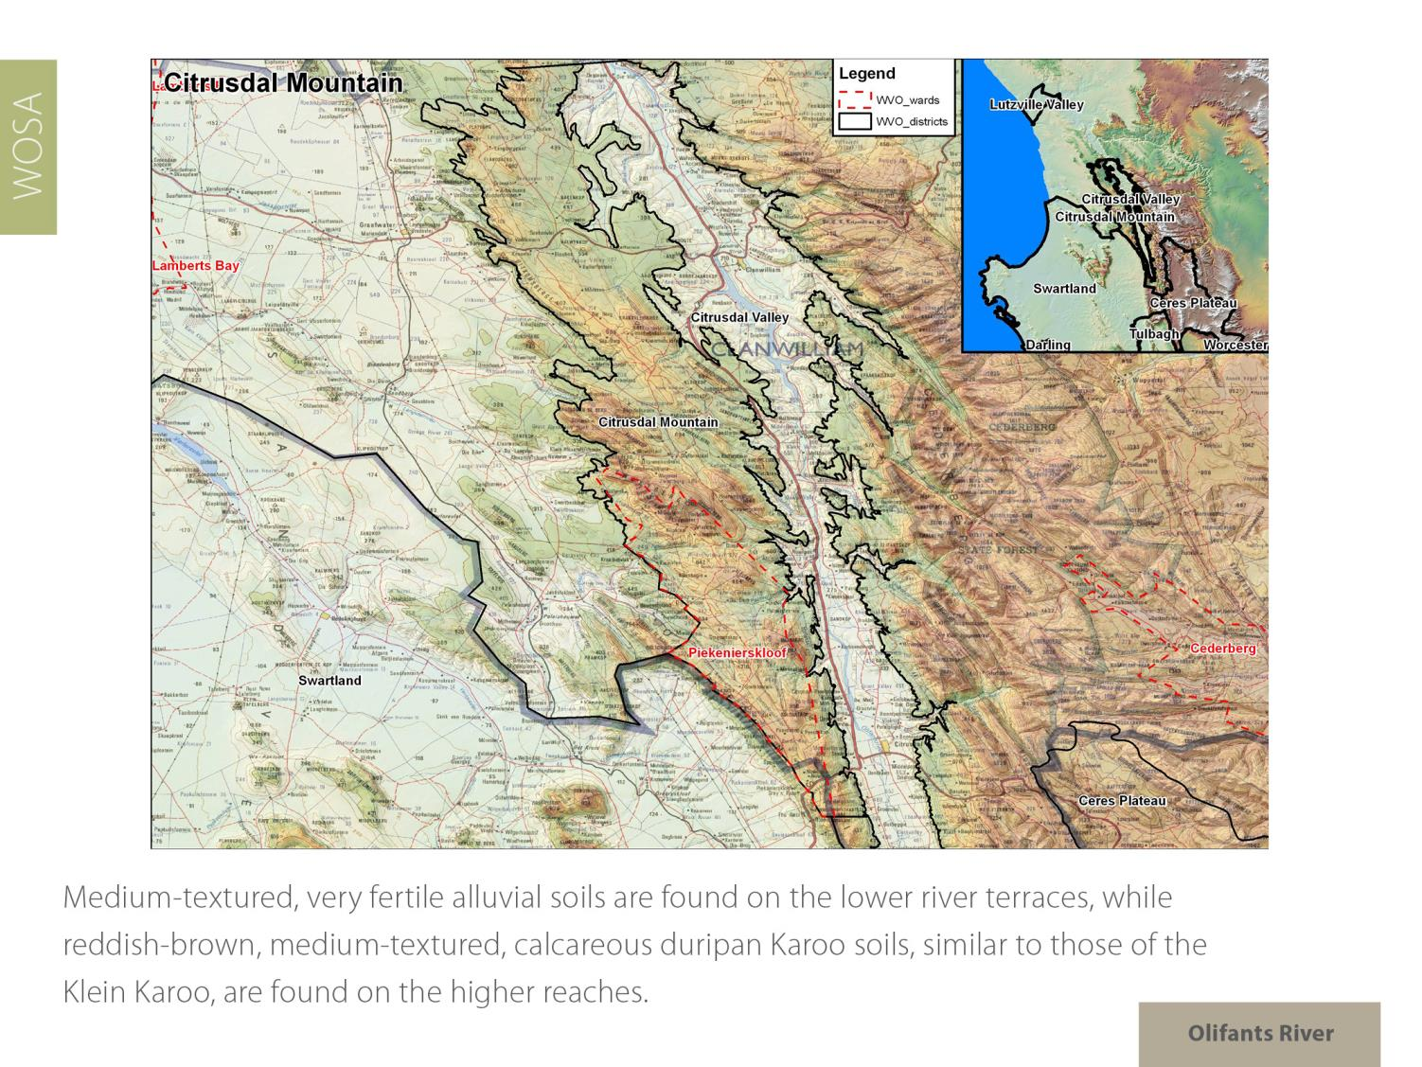
Olifants River

Slide 21
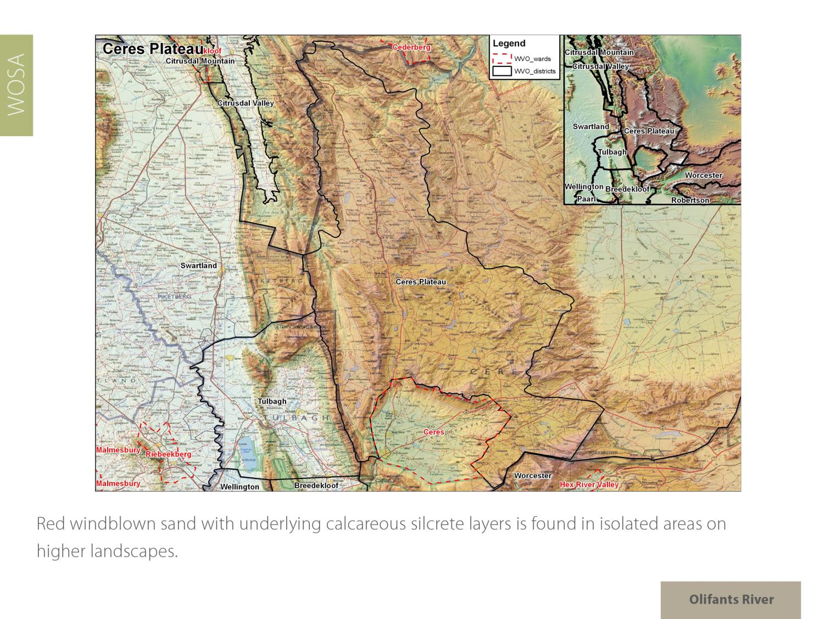
Olifants River

Slide 22
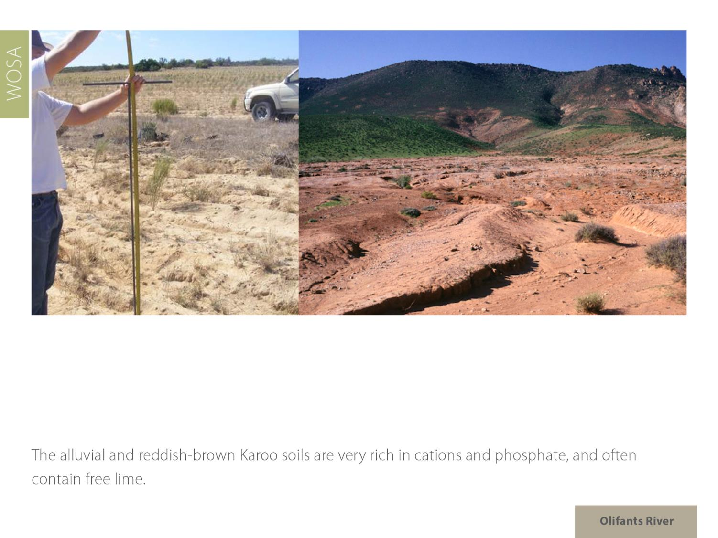
Olifants River

Slide 23
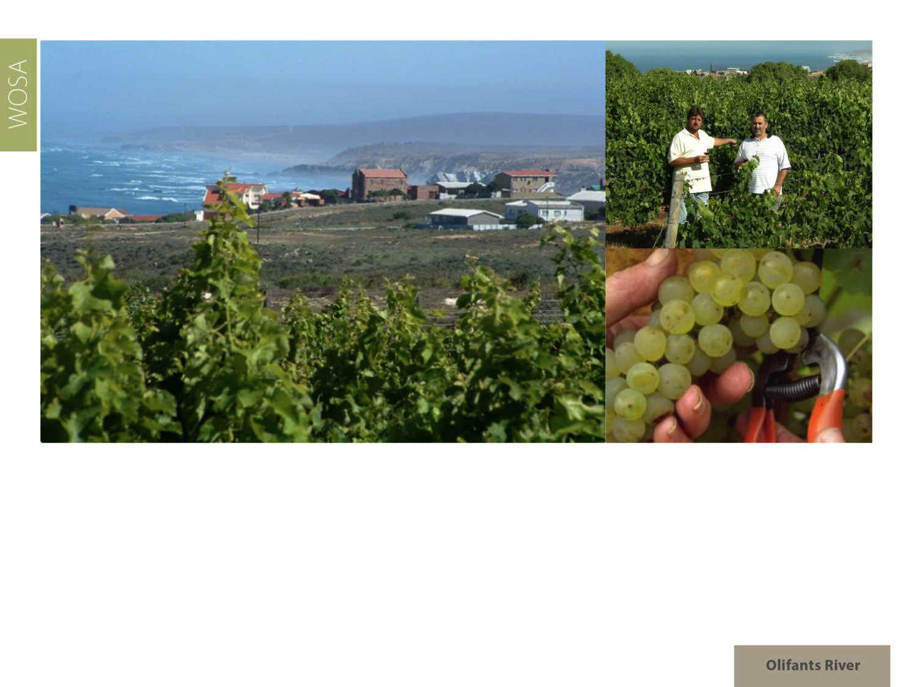
Closer to the cold Atlantic Ocean in the vicinity of Koekenaap vineyards can be found where cooler climates ensure high quality grapes. Further down the coast are the maritime vineyards of the stand-alone ward of Bamboes Bay.
Olifants River

Slide 24
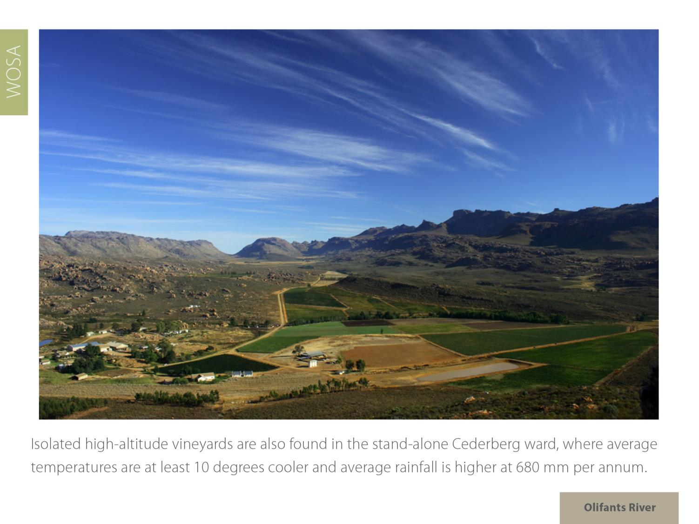
Isolated high-altitude vineyards are found in the high altitude wards of Piekenierskloof and stand-alone Cederberg, where the mean February temperature is 22.8⁰C and rainfall is 473 mm (Stagmanskop Weather Station).
Olifants River

Slide 25
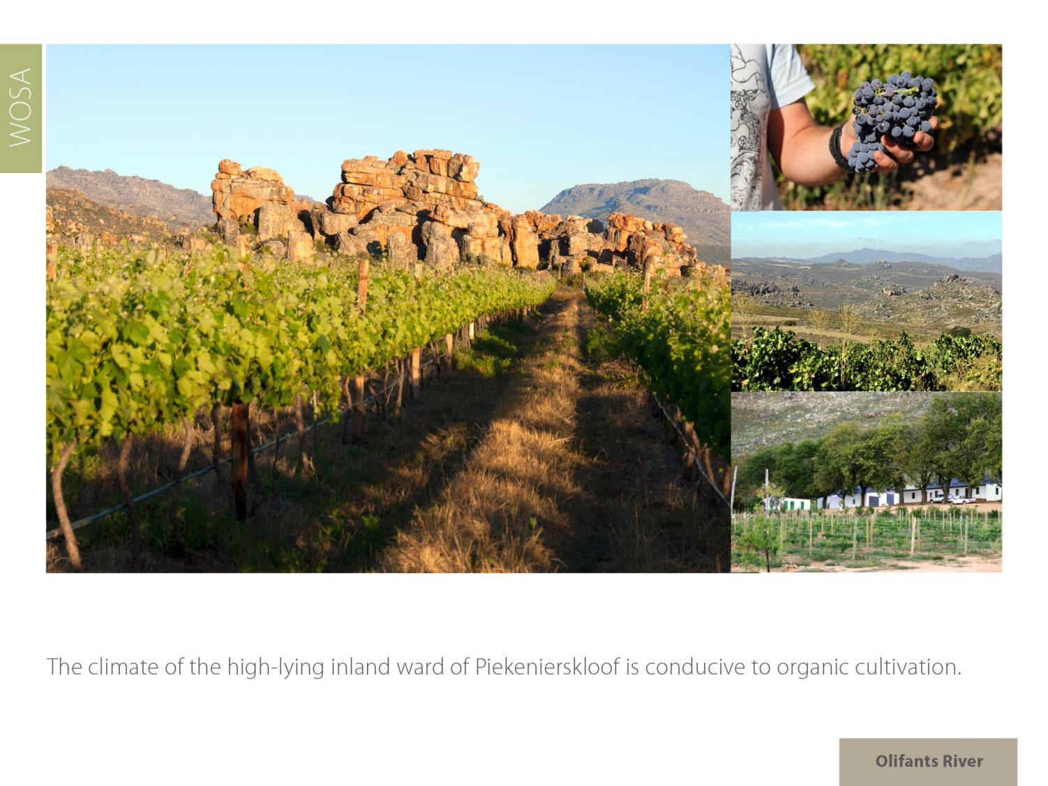
Olifants River

Slide 26
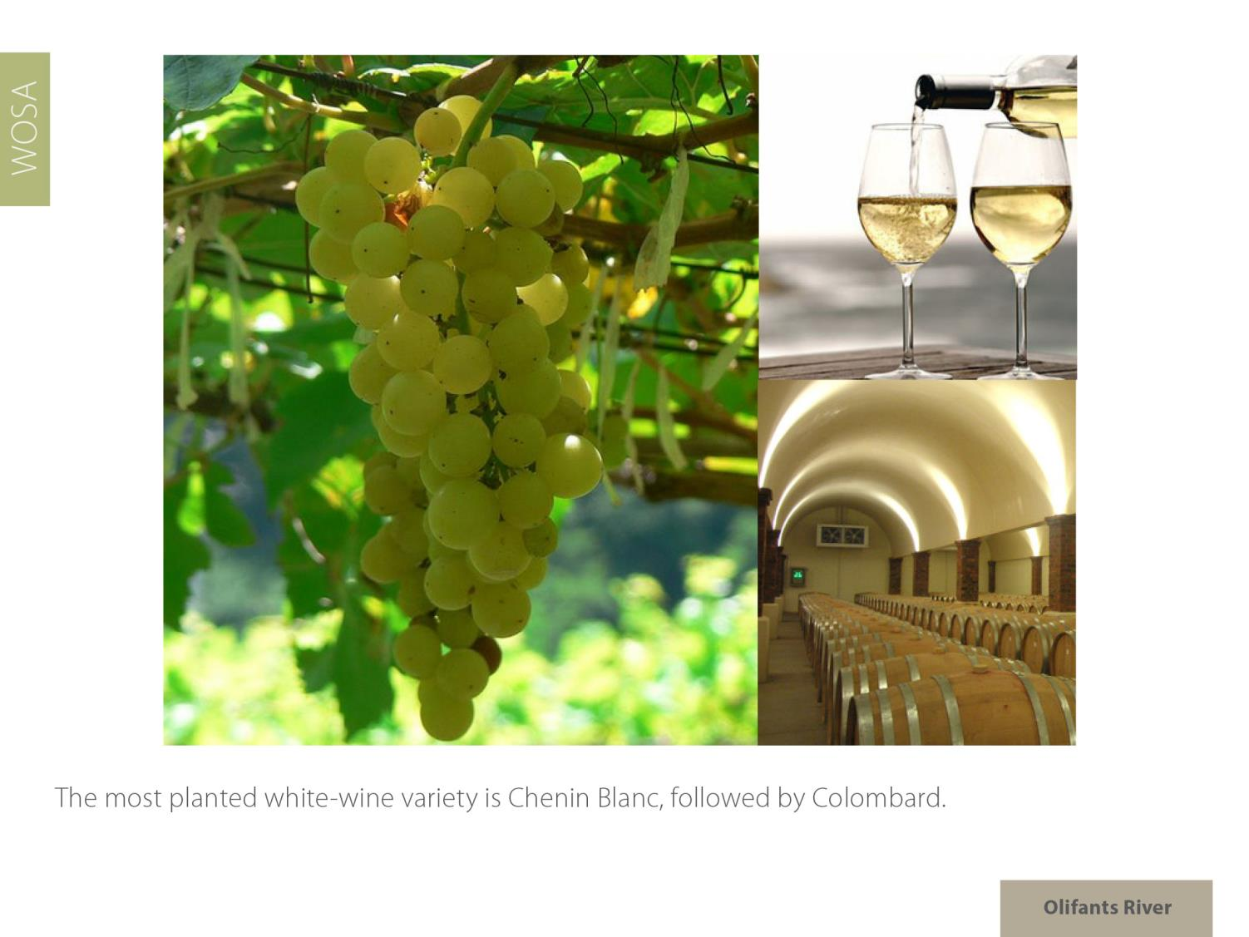
Olifants River

Slide 27
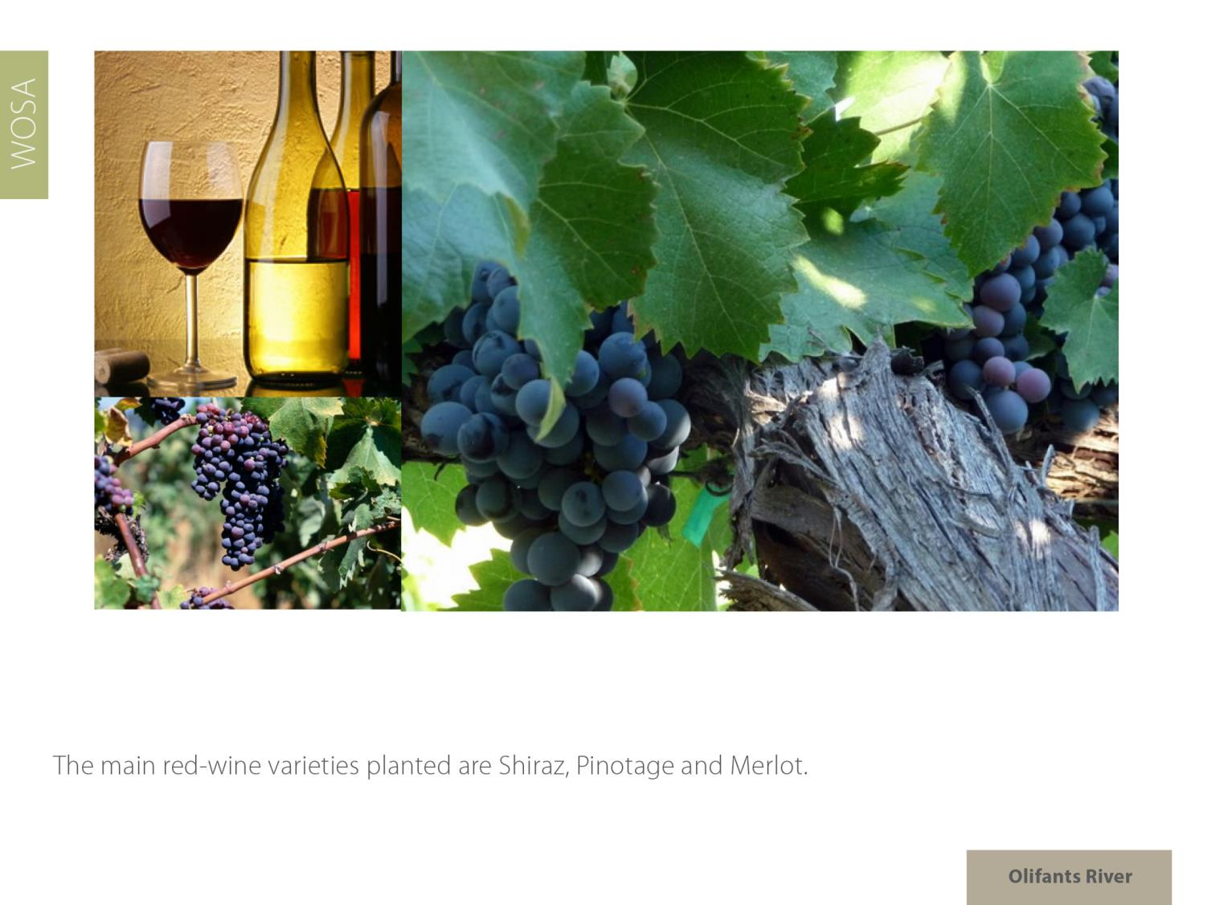

The main red-wine varieties planted are Shiraz, Pinotage and Ruby Cabernet.
Olifants River

Slide 28
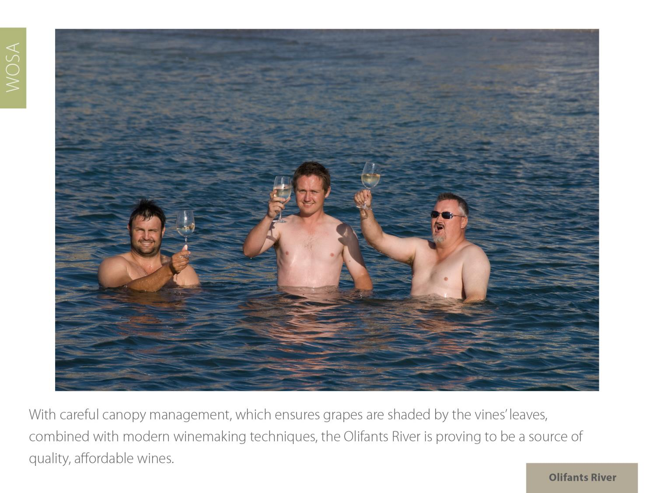
Olifants River

Slide 29
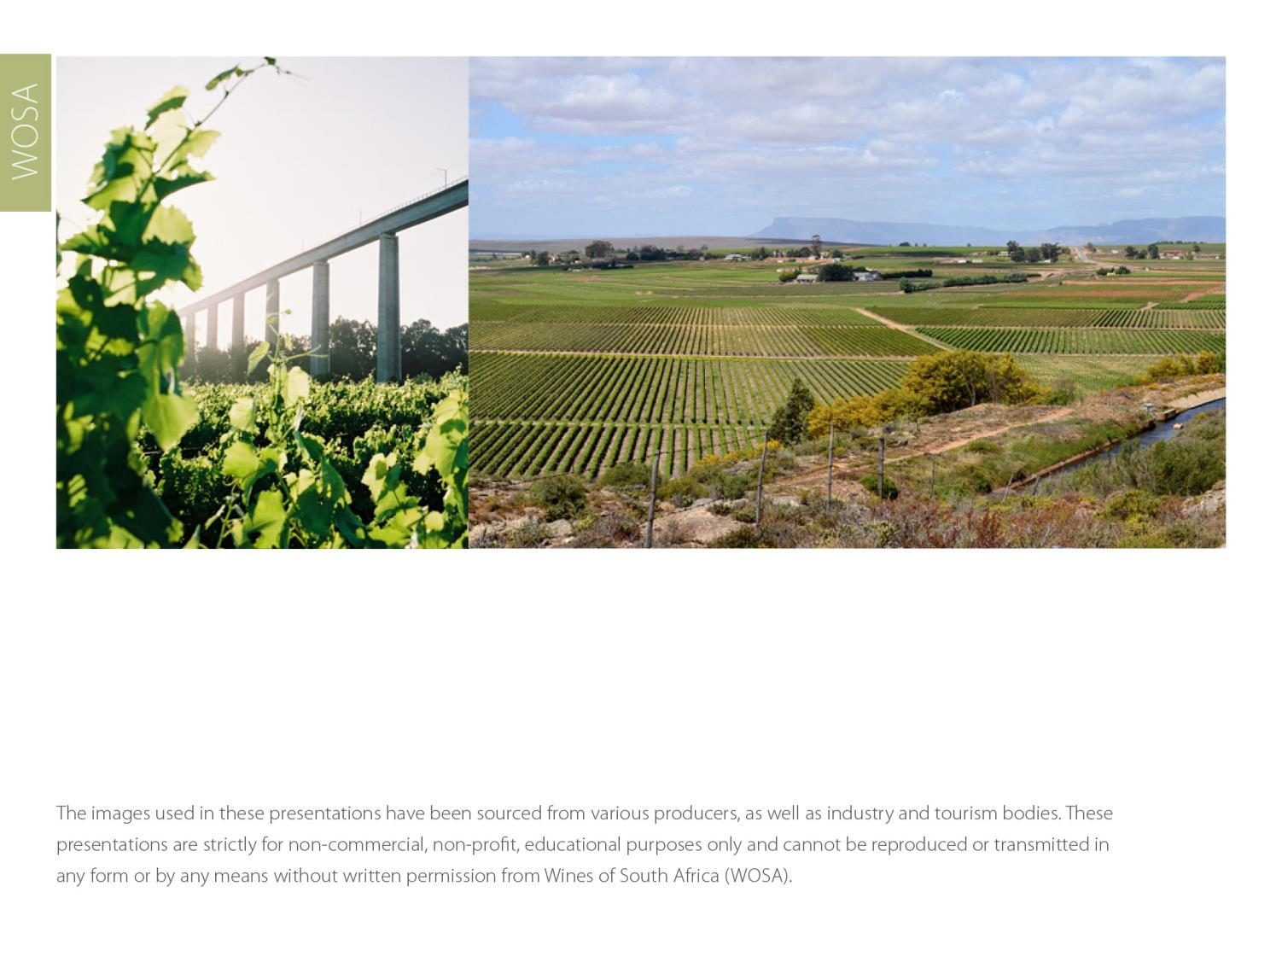
The images used in these presentations have been sourced from various producers, as well as industry and tourism bodies. These presentations are strictly for non-commercial, non-profit, educational purposes only and cannot be reproduced or transmitted in any form or by any means without written permission from Wines of South Africa (WoSA).

Slide 30
The Cape winelands, considered by many to be
the most beautiful in the world, have a network of
diverse and well-run wine routes, affording visitors
a varied and unforgettable experience.

Slide 31
THE END

